Slide 1
If climate change is a super wicked problem, is social marketing a super wicked solution?
David Meiklejohn
Notes:
Hello
Re-iterate title briefly
➔

Slide 2
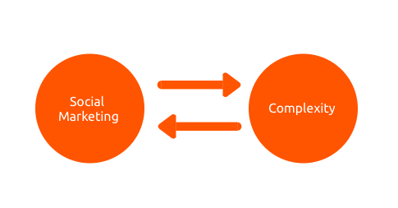
Introduction | Climate Change Social Marketing | Super Wicked Analysis | Opportunities
Introduction
Notes:
Seek to better understand the complexity of climate change, as it relates directly to social marketing responses
and
Assess whether social marketing approaches meet that complexity designers assess and meet these complexity demands?

Slide 3
Introduction
Guiding Frameworks for Climate Change Social Marketing
Climate Change as a Super Wicked Problem
Implications for Climate Change Social Marketing

Slide 4
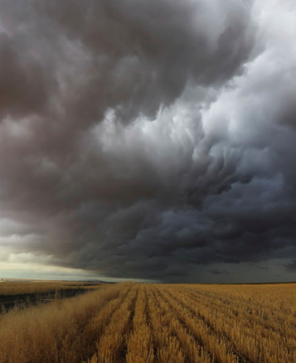
Introduction | Climate Change Social Marketing | Super Wicked Analysis | Opportunities
Introduction
Australian government responses to climate change:
incentives
regulations
behaviour change programs
Wilkins 2008
Notes:
Since the 1980s, Australian government responses are at all levels – Federal, state and local – and address all sectors of society and the economy.
Incentives – generous feed-in tariffs to support rooftop solar
Regulatory – such as. carbon pricing
Behaviour change – ranging from the large scale TravelSmart and LivingSmart programs in WA, to much smaller approaches at local government level, such as workshops on related issues, such as energy conservation.

Slide 5
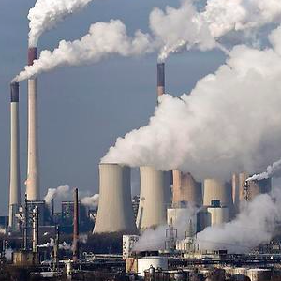
Introduction | Climate Change Social Marketing | Super Wicked Analysis | Opportunities
Guiding Frameworks
Climate Change
Individuals
Notes:
Do we address climate change or ignore it?
Many of the traditional models of voluntary climate change response programs have been based on a variation of this model, with limited success.
The problem may be that there is only a limited number of people who respond to this idea of climate change as a mobilising influence. It brings a moral dimension, which as I’ll talk about later, can be problematic.
How do we consider the role of individuals?
We are rational, decision-making agents in control of our destiny.

Slide 6
Introduction | Climate Change Social Marketing | Super Wicked Analysis | Opportunities
Climate Change Social Marketing
Information Deficit Model:
I lack
information
I have
information
I act on
information
Notes:
Many of the traditional models of voluntary climate change response programs have been based on a variation of this model, with limited success.
The problem may be that there is only a limited number of people who respond to this idea of climate change as a mobilising influence. It brings a moral dimension, which as I’ll talk about later, can be problematic.
But when considering whether to talk about climate change at all in the context of voluntary responses, there are alternatives ➔

Slide 7
Introduction | Climate Change Social Marketing | Super Wicked Analysis | Opportunities
Super Wicked Problems
There is a limited time to respond.
They are caused by those seeking the solution.
There is weak or non-existent central authority.
Future benefits are discounted.
Levin et. al 2007
Notes:
Emerged from wicked problems, which themselves emerged in the late 1960s. As we solved easier, often technical problems (such as how to install sewerage to a city, we moved onto more intractable problems that involved a range of interlocking complexities, such as how to solve poverty?
Super wicked problems advance this specifically for climate change Consists of four complexity problems.
Now, I’ll examine each of these complexity factors and their implications for voluntary responses to climate change.

Slide 8
Introduction | Climate Change Social Marketing | Super Wicked Analysis | Opportunities
Limited Time to Respond
Feedback loops of climate change require action now.
Scale can be overwhelming.
Anderson & Bows 2011
Notes:
Climate change is unique as a problem as it contributes to its own future growth through a series of bio-feedback loops.
For example, as the earth warms, the Siberian permafrost is melting releasing an average 3.8 million tons of methane which had previously been trapped, adding further to exponential growth in greenhouse gases.
We are not only moving towards a dangerous climate future; it is also moving towards us.
In addition, as the impacts of climate change grow in severity, the scale of the problem can be challenging for individuals to consider.

Slide 9
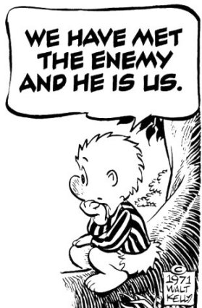
Introduction | Climate Change Social Marketing | Super Wicked Analysis | Opportunities
Caused by Those Seeking the Solution
We gain by not acting.
We don’t identify with the issue, both in values and practices.
Climate change as a contested discourse.
Notes:
There is a wide range of individual and social barriers to people taking action on climate change, including these listed.
Currently, it is to our financial benefit not to act, though this is shifting in some areas, such as solar that I’ve already mentioned.
Identification with the issue – this comes back to those key considerations I mentioned earlier: the role of climate change and the role of the individual.
When responding to climate change we tend to be guided by our their own personal values and ideologies as by facts when thinking about the science. It should be noted that this also varies between countries – the most extreme examples of this are in Anglo-Saxon countries including the US, Australia, Canada and the UK.
As for our practices – we don’t think of turning on the air conditioner as energy consumption, we think of it as wanting to be cool.
In a contested discourse, people are guided as much by, and so this proves a real challenge for some engagement models, such as the Information-Deficit Model.

Slide 10
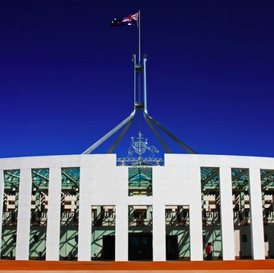
Introduction | Climate Change Social Marketing | Super Wicked Analysis | Opportunities
Weak or Non-Existent Central Authority
Government wants individuals to act.
Complicated by declining trust and fluctuating levels of support for action.
Increasing role of local government.
Oliver 2014, Chubb 2014
Notes:
Governments want us to act to help deliver more effective policy outcomes.
The intensity of this relationship varies from the arguably more involved form of the Third Way, popular with centre left governments since the 1990s, with its emphasis on mutual obligations of citizen and state, to lighter touch approaches, such as the Green Army of the current Federal Government.
This approach has been made more difficult by declining levels of trust in government and fluctuating levels of support for action on climate change.
Finally, as both state and federal governments have withdrawn from the arena of tackling climate change, it has been left to local government to step up. As we shall see, local governments may not be adequately resourced to tackle a global issue, but they do have certain advantages when dealing with the impacts of climate change.

Slide 11
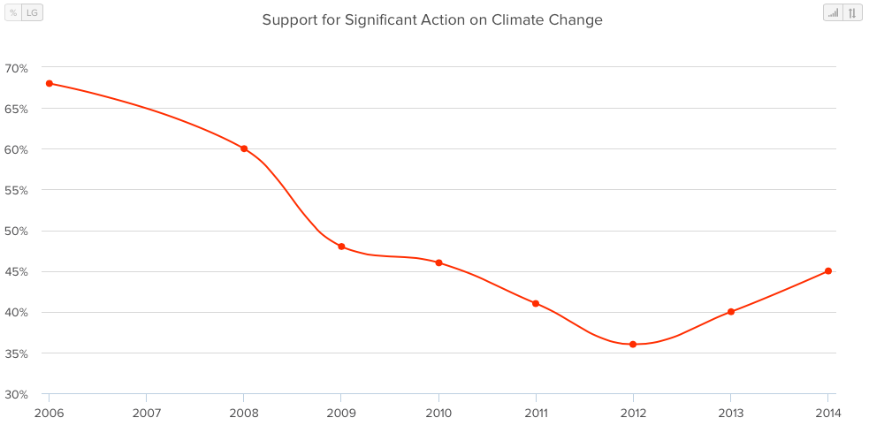
Introduction | Climate Change Social Marketing | Super Wicked Analysis | Opportunities
Fluctuating Public Support
Notes:
Governments want us to act to help deliver more effective policy outcomes.
The intensity of this relationship varies from the arguably more involved form of the Third Way, popular with centre left governments since the 1990s, with its emphasis on mutual obligations of citizen and state, to lighter touch approaches, such as the Green Army of the current Federal Government.
This approach has been made more difficult by declining levels of trust in government and fluctuating levels of support for action on climate change.
Finally, as both state and federal governments have withdrawn from the arena of tackling climate change, it has been left to local government to step up. As we shall see, local governments may not be adequately resourced to tackle a global issue, but they do have certain advantages when dealing with the impacts of climate change.

Slide 12
Introduction | Climate Change Social Marketing | Super Wicked Analysis | Opportunities
Weak or Non-Existent Central Authority
Government wants individuals to act.
Complicated by declining trust and fluctuating levels of support for action.
Increasing role of local government.
Oliver 2014, Chubb 2014
Notes:
Governments want us to act to help deliver more effective policy outcomes.
The intensity of this relationship varies from the arguably more involved form of the Third Way, popular with centre left governments since the 1990s, with its emphasis on mutual obligations of citizen and state, to lighter touch approaches, such as the Green Army of the current Federal Government.
This approach has been made more difficult by declining levels of trust in government and fluctuating levels of support for action on climate change.
Finally, as both state and federal governments have withdrawn from the arena of tackling climate change, it has been left to local government to step up. As we shall see, local governments may not be adequately resourced to tackle a global issue, but they do have certain advantages when dealing with the impacts of climate change.

Slide 13
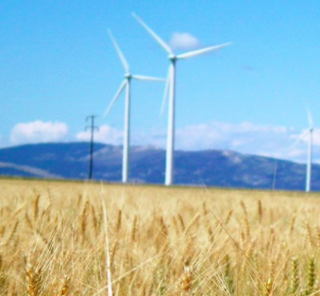
Introduction | Climate Change Social Marketing | Super Wicked Analysis | Opportunities
Future Benefits are Discounted
Valuing goods or benefits received now more than in the future.
Non-tangibles more difficult to value.
Hepburn et. al 2010
Notes:
Depends on initial value of good and time gap

Slide 14
Introduction | Climate Change Social Marketing | Super Wicked Analysis | Opportunities
Summary
There is a limited time to respond.
They are caused by those seeking the solution.
There is weak or non-existent central authority.
Future benefits are discounted.
What are the implications?
Notes:
So, what does all that mean for the future design of social marketing interventions?

Slide 15
Introduction | Climate Change Social Marketing | Super Wicked Analysis | Opportunities
Scale
Must use social networks in a sophisticated manner.
Track growth and anticipate where it is going.
Rogers 1995
Notes:
If the scale of your project is limited and has no or limited capacity to grow, then it is not an adequate response to climate change as a super wicked problem.
On the flip side, if you have the capacity to deliver at scale but only on the surface level, then it is doubtful whether you will actually achieve change.
A big part of this is branding – you have to question whether programs based around climate change as a motivating factor have the ability to go to scale. May be better to focus on specific elements and ignore the branding.
Diffusion Theory, with its identification of key audiences, such as Early Adopters, offers guidance but it is important to focus on behaviours or practices that you are seeking to change, not values. I’ll explore this more in the next complexity factor.
relative advantage
compatibility
complexity
trialability
observability

Slide 16
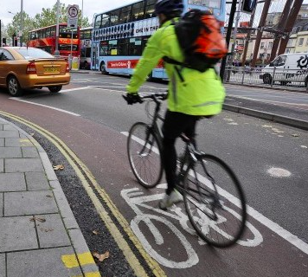
Introduction | Climate Change Social Marketing | Super Wicked Analysis | Opportunities
What People Do (Not What They Say)
Social Practice Theory
Shifts focus away from individual decision-making.
Notes:
Comprised of:
materials
competencies and
Meanings
Consider the example of someone cycling to work.

Slide 17
Introduction | Climate Change Social Marketing | Super Wicked Analysis | Opportunities
Move Away from Climate Change Branding
The growth of rooftop solar:
price of technology
saving energy costs
social norms
Sadler 2013
Notes:
You’ll be aware that installing rooftop solar PV has become more common in recent years.

Slide 18
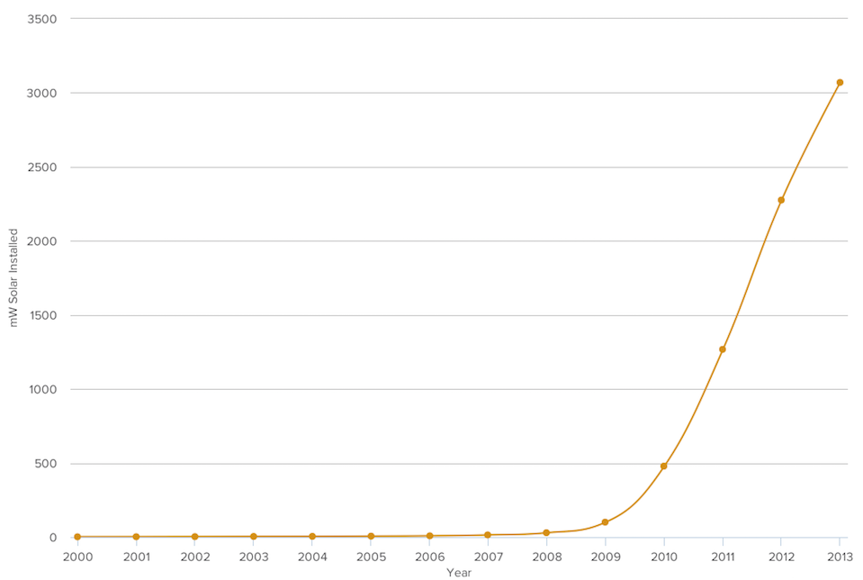
Introduction | Climate Change Social Marketing | Super Wicked Analysis | Opportunities
The Growth of Rooftop Solar
Watt et. al, 2014
Notes:
This is a voluntary response to climate change.

Slide 19
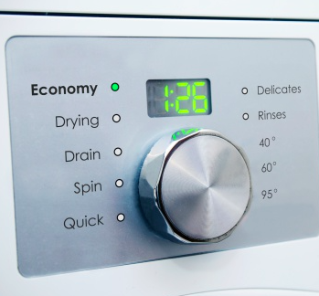
Introduction | Climate Change Social Marketing | Super Wicked Analysis | Opportunities
The Limits of Interventions
Overspill between behaviours is limited (if not non-existent).
Suggests limited environmental identity
Behavioural Insights Team 2014

Slide 20
Introduction | Climate Change Social Marketing | Super Wicked Analysis | Opportunities
Track and Respond
Evaluation is traditionally weak.
Need to look at guidance, as well as success factors.
Stop one-off interventions.
DEPI 2013
Notes:
Need to be more like major retailers that anticipate the needs of their customers and build a relationship over time.

Slide 21
Introduction | Climate Change Social Marketing | Super Wicked Analysis | Opportunities
Conclusion
Super wicked analysis provides a useful framework to identify current shortcomings.
Future research: working with local governments to test new approaches.

